Slide 1
Design and Analysis of Algorithm Branch and Bound (Travelling salesman Problem)
Lecture – 63

Slide 2
Overview
Branch and bound is an algorithm design paradigm for discrete and combinatorial optimization problems, as well as mathematical optimization.
Branch-and-bound algorithm consists of a systematic enumeration of solutions by means of state space search tree.
The set of solutions is thought of as forming a rooted tree with the full set at the root.
The algorithm explores branches of this tree, which represent subsets of the solution set.

Slide 3
Overview
The method was first proposed by Ailsa Land and Alison Doig whilst carrying out research at the London School of Economics sponsored by British Petroleum in 1960 for discrete programming, and has become the most commonly used tool for solving NP-hard optimization problems.
The name "branch and bound" first occurred in the work of Little et al. on the traveling salesman problem.
Branch and bound methods do not go deep like Depth-first search; the first direction is lateral movement in the tree similar to Breadth-first search (BFS).

Slide 4
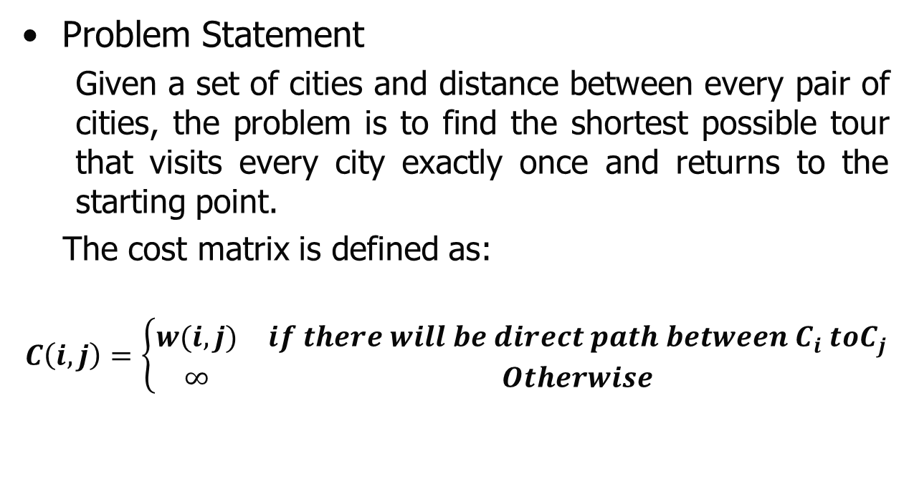
Travelling Salesman Problem
Problem Statement
Given a set of cities and distance between every pair of cities, the problem is to find the shortest possible tour that visits every city exactly once and returns to the starting point.
The cost matrix is defined as:
$$C\left(i,j\right)=\left\{\begin{matrix}w(i,j) & if there will be direct path between C_{i} toC_{j} \\ ∞ & Otherwise\end{matrix}\right.$$

Slide 5
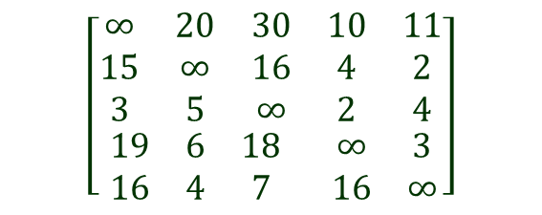


Travelling Salesman Problem
Example:
1
2
$$\begin{matrix}\begin{matrix}1 & 2 & 3\end{matrix} & \begin{matrix} 4 & 5\end{matrix}\end{matrix}$$
$$\left[\begin{matrix}\begin{matrix}∞ & 20 & 30 \\ 15 & ∞ & 16 \\ 3 & 5 & ∞\end{matrix} & \begin{matrix}10 & 11 \\ 4 & 2 \\ 2 & 4\end{matrix} \\ \begin{matrix}19 & 6 & 18 \\ 16 & 4 & 7\end{matrix} & \begin{matrix}∞ & 3 \\ 16 & ∞\end{matrix}\end{matrix}\right]$$
$$\begin{matrix}\begin{matrix}1 \\ 2 \\ 3\end{matrix} \\ \begin{matrix}4 \\ 5\end{matrix}\end{matrix}$$
4
3
5
Graph
Cost Matrix of the Graph

Slide 6
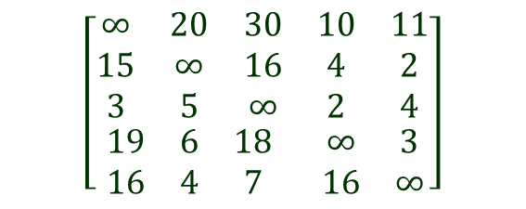


Travelling Salesman Problem
Example:
Step 1: First reduce the cost of above matrix(i.e Reducing matrix)
$$\begin{matrix}\begin{matrix}1 & 2 & 3\end{matrix} & \begin{matrix} 4 & 5\end{matrix}\end{matrix}$$
$$\left[\begin{matrix}\begin{matrix}∞ & 20 & 30 \\ 15 & ∞ & 16 \\ 3 & 5 & ∞\end{matrix} & \begin{matrix}10 & 11 \\ 4 & 2 \\ 2 & 4\end{matrix} \\ \begin{matrix}19 & 6 & 18 \\ 16 & 4 & 7\end{matrix} & \begin{matrix}∞ & 3 \\ 16 & ∞\end{matrix}\end{matrix}\right]$$
$$\begin{matrix}\begin{matrix}1 \\ 2 \\ 3\end{matrix} \\ \begin{matrix}4 \\ 5\end{matrix}\end{matrix}$$

Slide 7
Travelling Salesman Problem
Example:
Step 1: First reduce the cost of above matrix(i.e Reducing matrix)
$$\begin{matrix}\begin{matrix}1 & 2 & 3\end{matrix} & \begin{matrix} 4 & 5\end{matrix}\end{matrix}$$
Find the minimum value of each row and then create the resultant matrix by subtracting the minimum value from each element of the same row (i.e Reduced Row)
$$\left[\begin{matrix}\begin{matrix}∞ & 20 & 30 \\ 15 & ∞ & 16 \\ 3 & 5 & ∞\end{matrix} & \begin{matrix}10 & 11 \\ 4 & 2 \\ 2 & 4\end{matrix} \\ \begin{matrix}19 & 6 & 18 \\ 16 & 4 & 7\end{matrix} & \begin{matrix}∞ & 3 \\ 16 & ∞\end{matrix}\end{matrix}\right]$$
$$\begin{matrix}\begin{matrix}1 \\ 2 \\ 3\end{matrix} \\ \begin{matrix}4 \\ 5\end{matrix}\end{matrix}$$

Slide 8
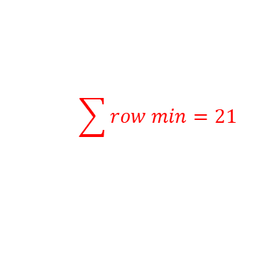

Travelling Salesman Problem
Example:
Step 1: First reduce the cost of above matrix(i.e Reducing matrix)
$$\begin{matrix}\begin{matrix}1 & 2 & 3\end{matrix} & \begin{matrix} 4 & 5\end{matrix}\end{matrix}$$
Find the minimum value of each row and then create the resultant matrix by subtracting the minimum value from each element of the same row (i.e Reduced Row)
$$\left[\begin{matrix}\begin{matrix}∞ & 20 & 30 \\ 15 & ∞ & 16 \\ 3 & 5 & ∞\end{matrix} & \begin{matrix}10 & 11 \\ 4 & 2 \\ 2 & 4\end{matrix} \\ \begin{matrix}19 & 6 & 18 \\ 16 & 4 & 7\end{matrix} & \begin{matrix}∞ & 3 \\ 16 & ∞\end{matrix}\end{matrix}\right]$$
$$\begin{matrix}\begin{matrix}1 \\ 2 \\ 3\end{matrix} \\ \begin{matrix}4 \\ 5\end{matrix}\end{matrix}$$
$$\begin{matrix}\begin{matrix}10 \\ 2 \\ 2\end{matrix} \\ \begin{matrix}3 \\ 4\end{matrix}\end{matrix}$$
$$\sum{row min}=21$$

Slide 9




Travelling Salesman Problem
Example:
Step 1: First reduce the cost of above matrix(i.e Reducing matrix)
$$\begin{matrix}\begin{matrix}1 & 2 & 3\end{matrix} & \begin{matrix} 4 & 5\end{matrix}\end{matrix}$$
Find the minimum value of each row and then create the resultant matrix by subtracting the minimum value from each element of the same row (i.e Reduced Row)
$$\left[\begin{matrix}\begin{matrix}∞ & 20 & 30 \\ 15 & ∞ & 16 \\ 3 & 5 & ∞\end{matrix} & \begin{matrix}10 & 11 \\ 4 & 2 \\ 2 & 4\end{matrix} \\ \begin{matrix}19 & 6 & 18 \\ 16 & 4 & 7\end{matrix} & \begin{matrix}∞ & 3 \\ 16 & ∞\end{matrix}\end{matrix}\right]$$
$$\begin{matrix}\begin{matrix}1 \\ 2 \\ 3\end{matrix} \\ \begin{matrix}4 \\ 5\end{matrix}\end{matrix}$$
$$\begin{matrix}\begin{matrix}10 \\ 2 \\ 2\end{matrix} \\ \begin{matrix}3 \\ 4\end{matrix}\end{matrix}$$
$$\sum{row min}=21$$
$$\begin{matrix}\begin{matrix}1 & 2 & 3\end{matrix} & \begin{matrix} 4 & 5\end{matrix}\end{matrix}$$
$$\left[\begin{matrix}\begin{matrix}∞ & 10 & 20 \\ 13 & ∞ & 14 \\ 1 & 3 & ∞\end{matrix} & \begin{matrix}0 & 1 \\ 2 & 0 \\ 0 & 2\end{matrix} \\ \begin{matrix}16 & 3 & 15 \\ 12 & 0 & 3\end{matrix} & \begin{matrix}∞ & 0 \\ 12 & ∞\end{matrix}\end{matrix}\right]$$
$$\begin{matrix}\begin{matrix}1 \\ 2 \\ 3\end{matrix} \\ \begin{matrix}4 \\ 5\end{matrix}\end{matrix}$$
$$\begin{matrix}\begin{matrix}10 \\ 2 \\ 2\end{matrix} \\ \begin{matrix}3 \\ 4\end{matrix}\end{matrix}$$

Slide 10
Travelling Salesman Problem
Example:
Step 1: First reduce the cost of above matrix(i.e Reducing matrix)
$$\begin{matrix}\begin{matrix}1 & 2 & 3\end{matrix} & \begin{matrix} 4 & 5\end{matrix}\end{matrix}$$
Find the minimum value of each row and then create the resultant matrix by subtracting the minimum value from each element of the same row (i.e Reduced Row)
$$\left[\begin{matrix}\begin{matrix}∞ & 20 & 30 \\ 15 & ∞ & 16 \\ 3 & 5 & ∞\end{matrix} & \begin{matrix}10 & 11 \\ 4 & 2 \\ 2 & 4\end{matrix} \\ \begin{matrix}19 & 6 & 18 \\ 16 & 4 & 7\end{matrix} & \begin{matrix}∞ & 3 \\ 16 & ∞\end{matrix}\end{matrix}\right]$$
$$\begin{matrix}\begin{matrix}1 \\ 2 \\ 3\end{matrix} \\ \begin{matrix}4 \\ 5\end{matrix}\end{matrix}$$
$$\begin{matrix}\begin{matrix}10 \\ 2 \\ 2\end{matrix} \\ \begin{matrix}3 \\ 4\end{matrix}\end{matrix}$$
$$\sum{row min}=21$$
$$\begin{matrix}\begin{matrix}1 & 2 & 3\end{matrix} & \begin{matrix} 4 & 5\end{matrix}\end{matrix}$$
Find the minimum value of each column and then create the resultant matrix by subtracting the minimum value from each element of the same row (i.e Reduced column)
$$\left[\begin{matrix}\begin{matrix}∞ & 10 & 20 \\ 13 & ∞ & 14 \\ 1 & 3 & ∞\end{matrix} & \begin{matrix}0 & 1 \\ 2 & 0 \\ 0 & 2\end{matrix} \\ \begin{matrix}16 & 3 & 15 \\ 12 & 0 & 3\end{matrix} & \begin{matrix}∞ & 0 \\ 12 & ∞\end{matrix}\end{matrix}\right]$$
$$\begin{matrix}\begin{matrix}1 \\ 2 \\ 3\end{matrix} \\ \begin{matrix}4 \\ 5\end{matrix}\end{matrix}$$
$$\begin{matrix}\begin{matrix}10 \\ 2 \\ 2\end{matrix} \\ \begin{matrix}3 \\ 4\end{matrix}\end{matrix}$$

Slide 11

Travelling Salesman Problem
Example:
Step 1: First reduce the cost of above matrix(i.e Reducing matrix)
$$\begin{matrix}\begin{matrix}1 & 2 & 3\end{matrix} & \begin{matrix} 4 & 5\end{matrix}\end{matrix}$$
Find the minimum value of each row and then create the resultant matrix by subtracting the minimum value from each element of the same row (i.e Reduced Row)
$$\left[\begin{matrix}\begin{matrix}∞ & 20 & 30 \\ 15 & ∞ & 16 \\ 3 & 5 & ∞\end{matrix} & \begin{matrix}10 & 11 \\ 4 & 2 \\ 2 & 4\end{matrix} \\ \begin{matrix}19 & 6 & 18 \\ 16 & 4 & 7\end{matrix} & \begin{matrix}∞ & 3 \\ 16 & ∞\end{matrix}\end{matrix}\right]$$
$$\begin{matrix}\begin{matrix}1 \\ 2 \\ 3\end{matrix} \\ \begin{matrix}4 \\ 5\end{matrix}\end{matrix}$$
$$\begin{matrix}\begin{matrix}10 \\ 2 \\ 2\end{matrix} \\ \begin{matrix}3 \\ 4\end{matrix}\end{matrix}$$
$$\sum{row min}=21$$
$$\begin{matrix}\begin{matrix}1 & 2 & 3\end{matrix} & \begin{matrix} 4 & 5\end{matrix}\end{matrix}$$
Find the minimum value of each column and then create the resultant matrix by subtracting the minimum value from each element of the same row (i.e Reduced column)
$$\left[\begin{matrix}\begin{matrix}∞ & 10 & 20 \\ 13 & ∞ & 14 \\ 1 & 3 & ∞\end{matrix} & \begin{matrix}0 & 1 \\ 2 & 0 \\ 0 & 2\end{matrix} \\ \begin{matrix}16 & 3 & 15 \\ 12 & 0 & 3\end{matrix} & \begin{matrix}∞ & 0 \\ 12 & ∞\end{matrix}\end{matrix}\right]$$
$$\begin{matrix}\begin{matrix}1 \\ 2 \\ 3\end{matrix} \\ \begin{matrix}4 \\ 5\end{matrix}\end{matrix}$$
$$\begin{matrix}\begin{matrix}10 \\ 2 \\ 2\end{matrix} \\ \begin{matrix}3 \\ 4\end{matrix}\end{matrix}$$
$$\begin{matrix}\begin{matrix}1 & 0 & 3\end{matrix} & \begin{matrix} 0 & 0\end{matrix}\end{matrix}$$

Slide 12
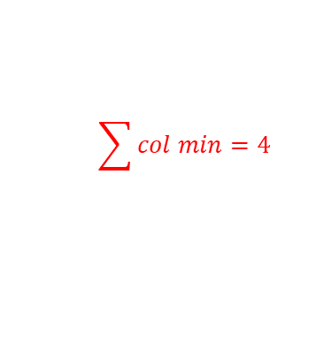

Travelling Salesman Problem
Example:
Step 1: First reduce the cost of above matrix(i.e Reducing matrix)
$$\begin{matrix}\begin{matrix}1 & 2 & 3\end{matrix} & \begin{matrix} 4 & 5\end{matrix}\end{matrix}$$
Find the minimum value of each row and then create the resultant matrix by subtracting the minimum value from each element of the same row (i.e Reduced Row)
$$\left[\begin{matrix}\begin{matrix}∞ & 20 & 30 \\ 15 & ∞ & 16 \\ 3 & 5 & ∞\end{matrix} & \begin{matrix}10 & 11 \\ 4 & 2 \\ 2 & 4\end{matrix} \\ \begin{matrix}19 & 6 & 18 \\ 16 & 4 & 7\end{matrix} & \begin{matrix}∞ & 3 \\ 16 & ∞\end{matrix}\end{matrix}\right]$$
$$\begin{matrix}\begin{matrix}1 \\ 2 \\ 3\end{matrix} \\ \begin{matrix}4 \\ 5\end{matrix}\end{matrix}$$
$$\begin{matrix}\begin{matrix}10 \\ 2 \\ 2\end{matrix} \\ \begin{matrix}3 \\ 4\end{matrix}\end{matrix}$$
$$\sum{row min}=21$$
$$\begin{matrix}\begin{matrix}1 & 2 & 3\end{matrix} & \begin{matrix} 4 & 5\end{matrix}\end{matrix}$$
Find the minimum value of each column and then create the resultant matrix by subtracting the minimum value from each element of the same row (i.e Reduced column)
$$\left[\begin{matrix}\begin{matrix}∞ & 10 & 17 \\ 12 & ∞ & 11 \\ 0 & 3 & ∞\end{matrix} & \begin{matrix}0 & 1 \\ 2 & 0 \\ 0 & 2\end{matrix} \\ \begin{matrix}15 & 3 & 12 \\ 11 & 0 & 0\end{matrix} & \begin{matrix}∞ & 0 \\ 12 & ∞\end{matrix}\end{matrix}\right]$$
$$\begin{matrix}\begin{matrix}1 \\ 2 \\ 3\end{matrix} \\ \begin{matrix}4 \\ 5\end{matrix}\end{matrix}$$
$$\begin{matrix}\begin{matrix}10 \\ 2 \\ 2\end{matrix} \\ \begin{matrix}3 \\ 4\end{matrix}\end{matrix}$$
$$\begin{matrix}\begin{matrix}1 & 0 & 3\end{matrix} & \begin{matrix} 0 & 0\end{matrix}\end{matrix}$$
$$\sum{col min}=4$$

Slide 13
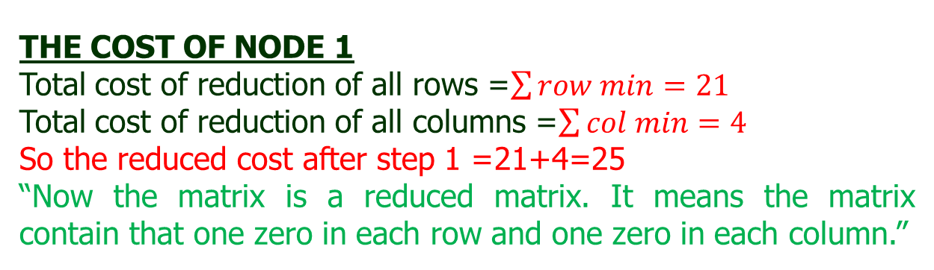


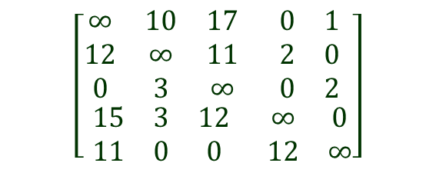
Travelling Salesman Problem
Example:
The final reduced matrix after step 1 is:
$$\begin{matrix}\begin{matrix}1 & 2 & 3\end{matrix} & \begin{matrix} 4 & 5\end{matrix}\end{matrix}$$
$$\left[\begin{matrix}\begin{matrix}∞ & 10 & 17 \\ 12 & ∞ & 11 \\ 0 & 3 & ∞\end{matrix} & \begin{matrix}0 & 1 \\ 2 & 0 \\ 0 & 2\end{matrix} \\ \begin{matrix}15 & 3 & 12 \\ 11 & 0 & 0\end{matrix} & \begin{matrix}∞ & 0 \\ 12 & ∞\end{matrix}\end{matrix}\right]$$
$$\begin{matrix}\begin{matrix}1 \\ 2 \\ 3\end{matrix} \\ \begin{matrix}4 \\ 5\end{matrix}\end{matrix}$$
C1=
THE COST OF NODE 1
Total cost of reduction of all rows =$\sum{row min}=21$
Total cost of reduction of all columns =$\sum{col min}=4$
So the reduced cost after step 1 =21+4=25
“Now the matrix is a reduced matrix. It means the matrix contain that one zero in each row and one zero in each column.”

Slide 14
Travelling Salesman Problem
Example:
From the step 1, it was observed that the cost of 1st node is 25. Hence the State space tree is
Now, we calculate the cost from node 1 to node 2, node 1 to node 3, node 1 to node 4, and node 1 to node 5.
And check, whether there is a minimum cost path from node 1 to node 2 or node 1 to node 3, node 1 to node 4 or node 1 to node 5 is exists? And find which one is minimum and explore that node again. And show the procedure through state space tree.
Let us do it one by one……..
C=25
1

Slide 15
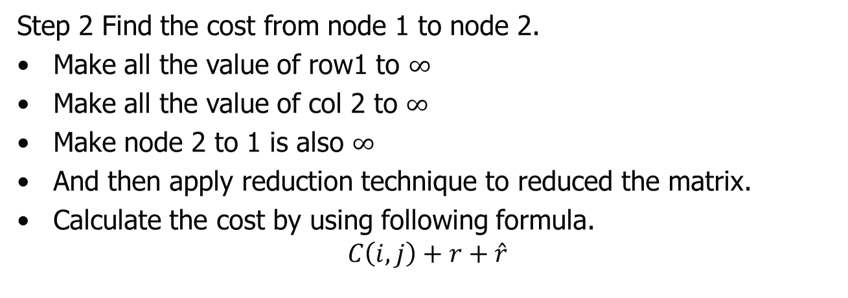
Travelling Salesman Problem
Example:
Step 2 Find the cost from node 1 to node 2.
Make all the value of row1 to $∞$
Make all the value of col 2 to $∞$
Make node 2 to 1 is also $∞$
And then apply reduction technique to reduced the matrix.
Calculate the cost by using following formula.
$$C\left(i,j\right)+r+\hat{r}$$
Cost from node i to j in reduction matrix
Reduction cost of current matrix
Reduced cost of node i . (calculated previously)

Slide 16
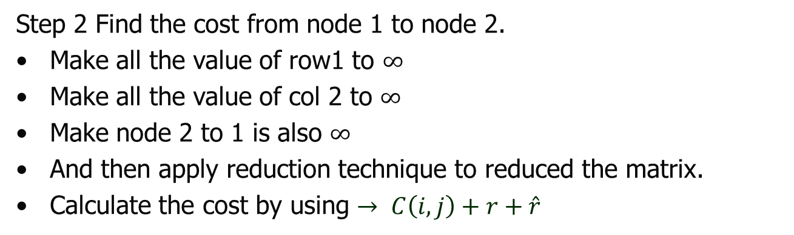


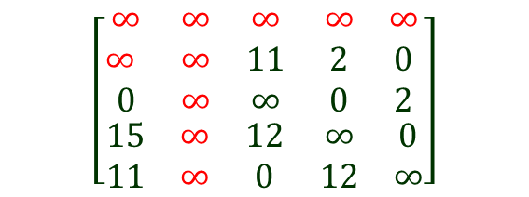
Travelling Salesman Problem
Example:
Step 2 Find the cost from node 1 to node 2.
Make all the value of row1 to $∞$
Make all the value of col 2 to $∞$
Make node 2 to 1 is also $∞$
And then apply reduction technique to reduced the matrix.
Calculate the cost by using $→ C\left(i,j\right)+r+\hat{r}$
$$\begin{matrix}\begin{matrix}1 & 2 & 3\end{matrix} & \begin{matrix} 4 & 5\end{matrix}\end{matrix}$$
$$\left[\begin{matrix}\begin{matrix}∞ & ∞ & ∞ \\ ∞ & ∞ & 11 \\ 0 & ∞ & ∞\end{matrix} & \begin{matrix}∞ & ∞ \\ 2 & 0 \\ 0 & 2\end{matrix} \\ \begin{matrix}15 & ∞ & 12 \\ 11 & ∞ & 0\end{matrix} & \begin{matrix}∞ & 0 \\ 12 & ∞\end{matrix}\end{matrix}\right]$$
$$\begin{matrix}\begin{matrix}1 \\ 2 \\ 3\end{matrix} \\ \begin{matrix}4 \\ 5\end{matrix}\end{matrix}$$

Slide 17
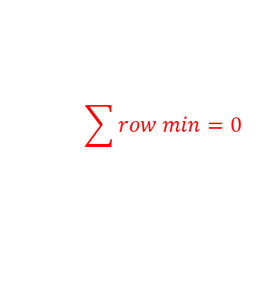

Travelling Salesman Problem
Example:
Step 2 Find the cost from node 1 to node 2.
Make all the value of row1 to $∞$
Make all the value of col 2 to $∞$
Make node 2 to 1 is also $∞$
And then apply reduction technique to reduced the matrix.
Calculate the cost by using $→ C\left(i,j\right)+r+\hat{r}$
$$\begin{matrix}\begin{matrix}1 & 2 & 3\end{matrix} & \begin{matrix} 4 & 5\end{matrix}\end{matrix}$$
$$\sum{row min}=0$$
$$\left[\begin{matrix}\begin{matrix}∞ & ∞ & ∞ \\ ∞ & ∞ & 11 \\ 0 & ∞ & ∞\end{matrix} & \begin{matrix}∞ & ∞ \\ 2 & 0 \\ 0 & 2\end{matrix} \\ \begin{matrix}15 & ∞ & 12 \\ 11 & ∞ & 0\end{matrix} & \begin{matrix}∞ & 0 \\ 12 & ∞\end{matrix}\end{matrix}\right]$$
$$\begin{matrix}\begin{matrix}1 \\ 2 \\ 3\end{matrix} \\ \begin{matrix}4 \\ 5\end{matrix}\end{matrix}$$
$$\begin{matrix}\begin{matrix}0 \\ 0 \\ 0\end{matrix} \\ \begin{matrix}0 \\ 0\end{matrix}\end{matrix}$$

Slide 18

Travelling Salesman Problem
Example:
Step 2 Find the cost from node 1 to node 2.
Make all the value of row1 to $∞$
Make all the value of col 2 to $∞$
Make node 2 to 1 is also $∞$
And then apply reduction technique to reduced the matrix.
Calculate the cost by using $→ C\left(i,j\right)+r+\hat{r}$
$$\begin{matrix}\begin{matrix}1 & 2 & 3\end{matrix} & \begin{matrix} 4 & 5\end{matrix}\end{matrix}$$
$$\sum{row min}=0$$
$$\sum{row min}=0$$
$$\left[\begin{matrix}\begin{matrix}∞ & ∞ & ∞ \\ ∞ & ∞ & 11 \\ 0 & ∞ & ∞\end{matrix} & \begin{matrix}∞ & ∞ \\ 2 & 0 \\ 0 & 2\end{matrix} \\ \begin{matrix}15 & ∞ & 12 \\ 11 & ∞ & 0\end{matrix} & \begin{matrix}∞ & 0 \\ 12 & ∞\end{matrix}\end{matrix}\right]$$
$$\begin{matrix}\begin{matrix}1 \\ 2 \\ 3\end{matrix} \\ \begin{matrix}4 \\ 5\end{matrix}\end{matrix}$$
$$\begin{matrix}\begin{matrix}0 \\ 0 \\ 0\end{matrix} \\ \begin{matrix}0 \\ 0\end{matrix}\end{matrix}$$
$$\begin{matrix}\begin{matrix}0 & 0 & 0\end{matrix} & \begin{matrix} 0 & 0\end{matrix}\end{matrix}$$

Slide 19
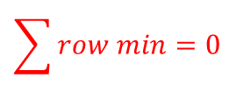
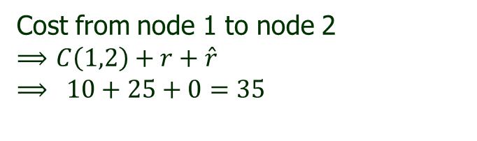
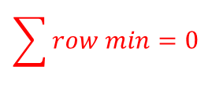
Travelling Salesman Problem
Example:
Step 2 Find the cost from node 1 to node 2.
Make all the value of row1 to $∞$
Make all the value of col 2 to $∞$
Make node 2 to 1 is also $∞$
And then apply reduction technique to reduced the matrix.
Calculate the cost by using $→ C\left(i,j\right)+r+\hat{r}$
$$\begin{matrix}\begin{matrix}1 & 2 & 3\end{matrix} & \begin{matrix} 4 & 5\end{matrix}\end{matrix}$$
$$\sum{row min}=0$$
$$\sum{row min}=0$$
$$\left[\begin{matrix}\begin{matrix}∞ & ∞ & ∞ \\ ∞ & ∞ & 11 \\ 0 & ∞ & ∞\end{matrix} & \begin{matrix}∞ & ∞ \\ 2 & 0 \\ 0 & 2\end{matrix} \\ \begin{matrix}15 & ∞ & 12 \\ 11 & ∞ & 0\end{matrix} & \begin{matrix}∞ & 0 \\ 12 & ∞\end{matrix}\end{matrix}\right]$$
$$\begin{matrix}\begin{matrix}1 \\ 2 \\ 3\end{matrix} \\ \begin{matrix}4 \\ 5\end{matrix}\end{matrix}$$
$$\begin{matrix}\begin{matrix}0 \\ 0 \\ 0\end{matrix} \\ \begin{matrix}0 \\ 0\end{matrix}\end{matrix}$$
Cost from node 1 to node 2
$⟹$ $C\left(1,2\right)+r+\hat{r}$
$$⟹ 10+25+0=35$$
$$\begin{matrix}\begin{matrix}0 & 0 & 0\end{matrix} & \begin{matrix} 0 & 0\end{matrix}\end{matrix}$$

Slide 20
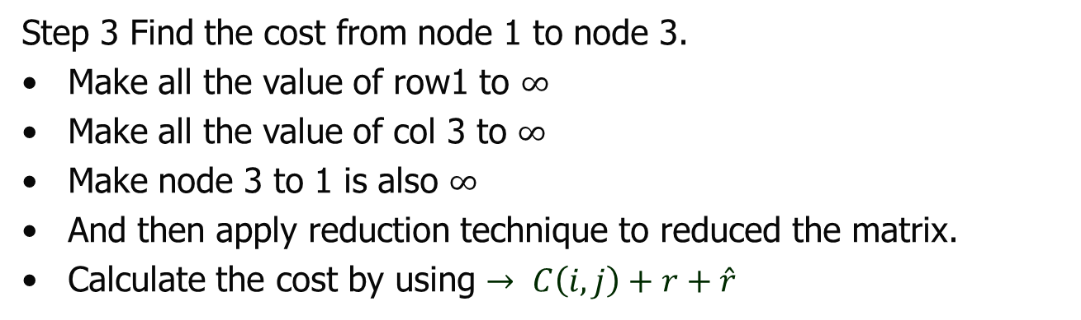
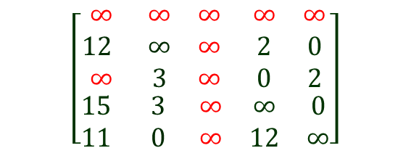
Travelling Salesman Problem
Example:
Step 3 Find the cost from node 1 to node 3.
Make all the value of row1 to $∞$
Make all the value of col 3 to $∞$
Make node 3 to 1 is also $∞$
And then apply reduction technique to reduced the matrix.
Calculate the cost by using $→ C\left(i,j\right)+r+\hat{r}$
$$\begin{matrix}\begin{matrix}1 & 2 & 3\end{matrix} & \begin{matrix} 4 & 5\end{matrix}\end{matrix}$$
$$\left[\begin{matrix}\begin{matrix}∞ & ∞ & ∞ \\ 12 & ∞ & ∞ \\ ∞ & 3 & ∞\end{matrix} & \begin{matrix}∞ & ∞ \\ 2 & 0 \\ 0 & 2\end{matrix} \\ \begin{matrix}15 & 3 & ∞ \\ 11 & 0 & ∞\end{matrix} & \begin{matrix}∞ & 0 \\ 12 & ∞\end{matrix}\end{matrix}\right]$$
$$\begin{matrix}\begin{matrix}1 \\ 2 \\ 3\end{matrix} \\ \begin{matrix}4 \\ 5\end{matrix}\end{matrix}$$

Slide 21
Travelling Salesman Problem
Example:
Step 3 Find the cost from node 1 to node 3.
Make all the value of row1 to $∞$
Make all the value of col 3 to $∞$
Make node 3 to 1 is also $∞$
And then apply reduction technique to reduced the matrix.
Calculate the cost by using $→ C\left(i,j\right)+r+\hat{r}$
$$\begin{matrix}\begin{matrix}1 & 2 & 3\end{matrix} & \begin{matrix} 4 & 5\end{matrix}\end{matrix}$$
$$\sum{row min}=0$$
$$\left[\begin{matrix}\begin{matrix}∞ & ∞ & ∞ \\ 12 & ∞ & ∞ \\ ∞ & 3 & ∞\end{matrix} & \begin{matrix}∞ & ∞ \\ 2 & 0 \\ 0 & 2\end{matrix} \\ \begin{matrix}15 & 3 & ∞ \\ 11 & 0 & ∞\end{matrix} & \begin{matrix}∞ & 0 \\ 12 & ∞\end{matrix}\end{matrix}\right]$$
$$\begin{matrix}\begin{matrix}1 \\ 2 \\ 3\end{matrix} \\ \begin{matrix}4 \\ 5\end{matrix}\end{matrix}$$
$$\begin{matrix}\begin{matrix}0 \\ 0 \\ 0\end{matrix} \\ \begin{matrix}0 \\ 0\end{matrix}\end{matrix}$$

Slide 22
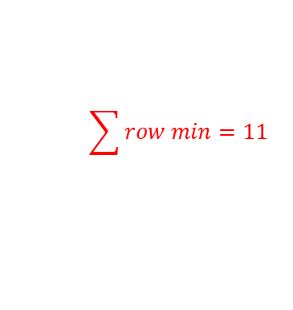

Travelling Salesman Problem
Example:
Step 3 Find the cost from node 1 to node 3.
Make all the value of row1 to $∞$
Make all the value of col 3 to $∞$
Make node 3 to 1 is also $∞$
And then apply reduction technique to reduced the matrix.
Calculate the cost by using $→ C\left(i,j\right)+r+\hat{r}$
$$\begin{matrix}\begin{matrix}1 & 2 & 3\end{matrix} & \begin{matrix} 4 & 5\end{matrix}\end{matrix}$$
$$\sum{row min}=0$$
$$\sum{row min}=11$$
$$\left[\begin{matrix}\begin{matrix}∞ & ∞ & ∞ \\ 12 & ∞ & ∞ \\ ∞ & 3 & ∞\end{matrix} & \begin{matrix}∞ & ∞ \\ 2 & 0 \\ 0 & 2\end{matrix} \\ \begin{matrix}15 & 3 & ∞ \\ 11 & 0 & ∞\end{matrix} & \begin{matrix}∞ & 0 \\ 12 & ∞\end{matrix}\end{matrix}\right]$$
$$\begin{matrix}\begin{matrix}1 \\ 2 \\ 3\end{matrix} \\ \begin{matrix}4 \\ 5\end{matrix}\end{matrix}$$
$$\begin{matrix}\begin{matrix}0 \\ 0 \\ 0\end{matrix} \\ \begin{matrix}0 \\ 0\end{matrix}\end{matrix}$$
$$\begin{matrix}\begin{matrix}11 & 0 & 0\end{matrix} & \begin{matrix} 0 & 0\end{matrix}\end{matrix}$$

Slide 23
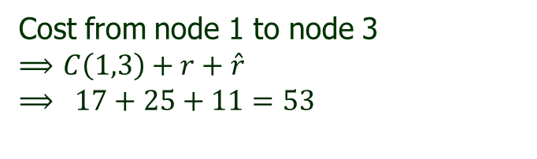
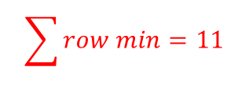
Travelling Salesman Problem
Example:
Step 3 Find the cost from node 1 to node 3.
Make all the value of row1 to $∞$
Make all the value of col 3 to $∞$
Make node 3 to 1 is also $∞$
And then apply reduction technique to reduced the matrix.
Calculate the cost by using $→ C\left(i,j\right)+r+\hat{r}$
$$\begin{matrix}\begin{matrix}1 & 2 & 3\end{matrix} & \begin{matrix} 4 & 5\end{matrix}\end{matrix}$$
$$\sum{row min}=0$$
$$\sum{row min}=11$$
$$\left[\begin{matrix}\begin{matrix}∞ & ∞ & ∞ \\ 12 & ∞ & ∞ \\ ∞ & 3 & ∞\end{matrix} & \begin{matrix}∞ & ∞ \\ 2 & 0 \\ 0 & 2\end{matrix} \\ \begin{matrix}15 & 3 & ∞ \\ 11 & 0 & ∞\end{matrix} & \begin{matrix}∞ & 0 \\ 12 & ∞\end{matrix}\end{matrix}\right]$$
$$\begin{matrix}\begin{matrix}1 \\ 2 \\ 3\end{matrix} \\ \begin{matrix}4 \\ 5\end{matrix}\end{matrix}$$
$$\begin{matrix}\begin{matrix}0 \\ 0 \\ 0\end{matrix} \\ \begin{matrix}0 \\ 0\end{matrix}\end{matrix}$$
Cost from node 1 to node 3
$⟹$ $C\left(1,3\right)+r+\hat{r}$
$$⟹ 17+25+11=53$$
$$\begin{matrix}\begin{matrix}11 & 0 & 0\end{matrix} & \begin{matrix} 0 & 0\end{matrix}\end{matrix}$$

Slide 24
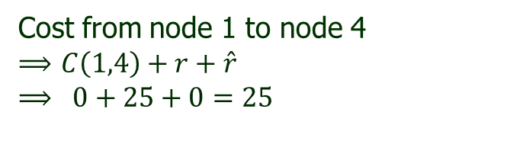
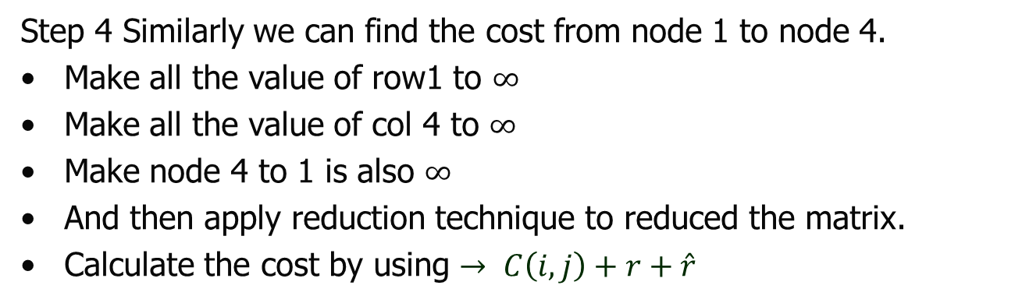
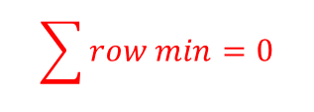

Travelling Salesman Problem
Example:
Step 4 Similarly we can find the cost from node 1 to node 4.
Make all the value of row1 to $∞$
Make all the value of col 4 to $∞$
Make node 4 to 1 is also $∞$
And then apply reduction technique to reduced the matrix.
Calculate the cost by using $→ C\left(i,j\right)+r+\hat{r}$
$$\begin{matrix}\begin{matrix}1 & 2 & 3\end{matrix} & \begin{matrix} 4 & 5\end{matrix}\end{matrix}$$
$$\sum{row min}=0$$
$$\sum{row min}=0$$
$$\left[\begin{matrix}\begin{matrix}∞ & ∞ & ∞ \\ 12 & ∞ & 11 \\ 0 & 3 & ∞\end{matrix} & \begin{matrix}∞ & ∞ \\ ∞ & 0 \\ ∞ & 2\end{matrix} \\ \begin{matrix}∞ & 3 & 12 \\ 11 & 0 & 0\end{matrix} & \begin{matrix}∞ & 0 \\ ∞ & ∞\end{matrix}\end{matrix}\right]$$
$$\begin{matrix}\begin{matrix}1 \\ 2 \\ 3\end{matrix} \\ \begin{matrix}4 \\ 5\end{matrix}\end{matrix}$$
$$\begin{matrix}\begin{matrix}0 \\ 0 \\ 0\end{matrix} \\ \begin{matrix}0 \\ 0\end{matrix}\end{matrix}$$
Cost from node 1 to node 4
$⟹$ $C\left(1,4\right)+r+\hat{r}$
$$⟹ 0+25+0=25$$
$$\begin{matrix}\begin{matrix}0 & 0 & 0\end{matrix} & \begin{matrix} 0 & 0\end{matrix}\end{matrix}$$

Slide 25

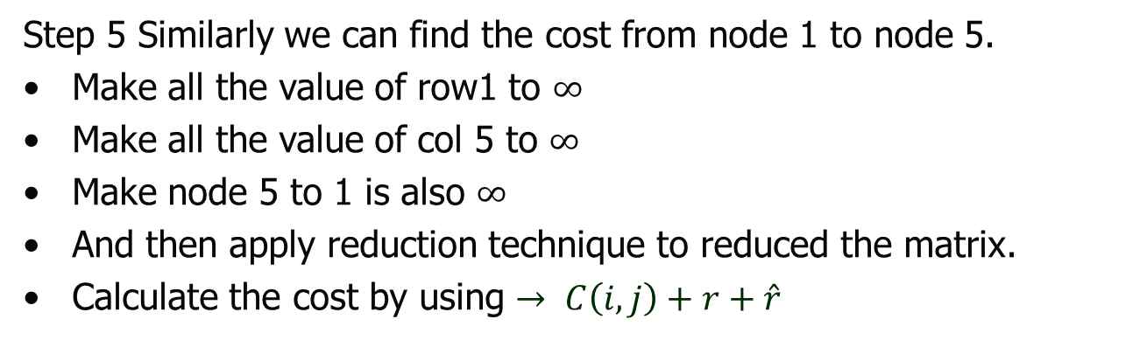
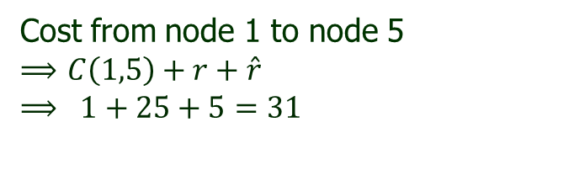


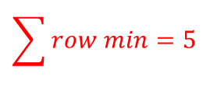

Travelling Salesman Problem
Example:
Step 5 Similarly we can find the cost from node 1 to node 5.
Make all the value of row1 to $∞$
Make all the value of col 5 to $∞$
Make node 5 to 1 is also $∞$
And then apply reduction technique to reduced the matrix.
Calculate the cost by using $→ C\left(i,j\right)+r+\hat{r}$
$$\sum{row min}=5$$
$$\sum{row min}=0$$
$$\begin{matrix}\begin{matrix}1 & 2 & 3\end{matrix} & \begin{matrix} 4 & 5\end{matrix}\end{matrix}$$
$$\left[\begin{matrix}\begin{matrix}∞ & ∞ & ∞ \\ 12 & ∞ & 11 \\ 0 & 3 & ∞\end{matrix} & \begin{matrix}∞ & ∞ \\ 2 & ∞ \\ 0 & ∞\end{matrix} \\ \begin{matrix}15 & 3 & 12 \\ ∞ & 0 & 0\end{matrix} & \begin{matrix}∞ & ∞ \\ 12 & ∞\end{matrix}\end{matrix}\right]$$
$$\begin{matrix}\begin{matrix}1 \\ 2 \\ 3\end{matrix} \\ \begin{matrix}4 \\ 5\end{matrix}\end{matrix}$$
$$\begin{matrix}\begin{matrix}0 \\ 2 \\ 0\end{matrix} \\ \begin{matrix}3 \\ 0\end{matrix}\end{matrix}$$
Cost from node 1 to node 5
$⟹$ $C\left(1,5\right)+r+\hat{r}$
$$⟹ 1+25+5=31$$
$$\begin{matrix}\begin{matrix}0 & 0 & 0\end{matrix} & \begin{matrix} 0 & 0\end{matrix}\end{matrix}$$

Slide 26
Travelling Salesman Problem
Example:
Hence
the cost from node 1 to node 2 =35
the cost from node 1 to node 3 =53
the cost from node 1 to node 4 =25
the cost from node 1 to node 5 =31
And the State space tree is given below:
C1=25
1
C2=35
C3=53
C4=25
C5=31
2
3
4
5

Slide 27
Travelling Salesman Problem
Example:
Hence
the cost from node 1 to node 2 =35
the cost from node 1 to node 3 =53
the cost from node 1 to node 4 =25
the cost from node 1 to node 5 =31
And the State space tree is given below:
C1=25
1
C2=35
C3=53
C4=25
C5=31
2
3
4
5
Find Minimum?

Slide 28
Travelling Salesman Problem
Example:
Hence
the cost from node 1 to node 2 =35
the cost from node 1 to node 3 =53
the cost from node 1 to node 4 =25 (Minimum)
the cost from node 1 to node 5 =31
C1=25
1
C2=35
C3=53
C4=25
C5=31
2
3
4
5

Slide 29
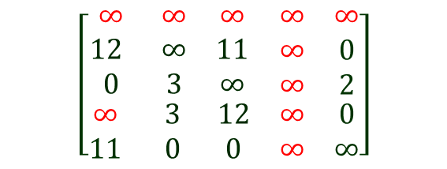


Travelling Salesman Problem
Example:
Hence
the cost from node 1 to node 2 =35
the cost from node 1 to node 3 =53
the cost from node 1 to node 4 =25 (Minimum)
the cost from node 1 to node 5 =31
$$\begin{matrix}\begin{matrix}1 & 2 & 3\end{matrix} & \begin{matrix} 4 & 5\end{matrix}\end{matrix}$$
1
C1=25
$$\left[\begin{matrix}\begin{matrix}∞ & ∞ & ∞ \\ 12 & ∞ & 11 \\ 0 & 3 & ∞\end{matrix} & \begin{matrix}∞ & ∞ \\ ∞ & 0 \\ ∞ & 2\end{matrix} \\ \begin{matrix}∞ & 3 & 12 \\ 11 & 0 & 0\end{matrix} & \begin{matrix}∞ & 0 \\ ∞ & ∞\end{matrix}\end{matrix}\right]$$
$$\begin{matrix}\begin{matrix}1 \\ 2 \\ 3\end{matrix} \\ \begin{matrix}4 \\ 5\end{matrix}\end{matrix}$$
2
C2=35
C3=53
C4=25
C5=31
3
4
5
“Hence the reduced matrix obtained from node 1to node 4 will be treated as reduced matrix for next level of the graph”

Slide 30
Travelling Salesman Problem
Example:
Hence
the cost from node 1 to node 2 =35
the cost from node 1 to node 3 =53
the cost from node 1 to node 4 =25 (Minimum)
the cost from node 1 to node 5 =31
$$\begin{matrix}\begin{matrix}1 & 2 & 3\end{matrix} & \begin{matrix} 4 & 5\end{matrix}\end{matrix}$$
C1=25
$$\left[\begin{matrix}\begin{matrix}∞ & ∞ & ∞ \\ 12 & ∞ & 11 \\ 0 & 3 & ∞\end{matrix} & \begin{matrix}∞ & ∞ \\ ∞ & 0 \\ ∞ & 2\end{matrix} \\ \begin{matrix}∞ & 3 & 12 \\ 11 & 0 & 0\end{matrix} & \begin{matrix}∞ & 0 \\ ∞ & ∞\end{matrix}\end{matrix}\right]$$
1
$$\begin{matrix}\begin{matrix}1 \\ 2 \\ 3\end{matrix} \\ \begin{matrix}4 \\ 5\end{matrix}\end{matrix}$$
2
C2=35
C3=53
C4=25
C5=31
3
4
5
“Hence the reduced matrix obtained from node 1 to node 4 will be treated as reduced matrix for next level of the graph”
Now further find who is the next vertex in next level?( i.e. node 2 or node 3 or node 5)
Hint: Apply the same methodology

Slide 31
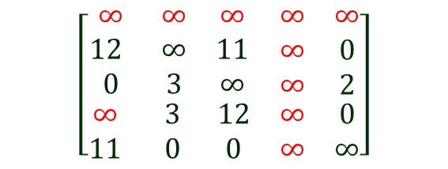


Travelling Salesman Problem
Example:
$$\begin{matrix}\begin{matrix}1 & 2 & 3\end{matrix} & \begin{matrix} 4 & 5\end{matrix}\end{matrix}$$
C1=25
$$\left[\begin{matrix}\begin{matrix}∞ & ∞ & ∞ \\ 12 & ∞ & 11 \\ 0 & 3 & ∞\end{matrix} & \begin{matrix}∞ & ∞ \\ ∞ & 0 \\ ∞ & 2\end{matrix} \\ \begin{matrix}∞ & 3 & 12 \\ 11 & 0 & 0\end{matrix} & \begin{matrix}∞ & 0 \\ ∞ & ∞\end{matrix}\end{matrix}\right]$$
1
$$\begin{matrix}\begin{matrix}1 \\ 2 \\ 3\end{matrix} \\ \begin{matrix}4 \\ 5\end{matrix}\end{matrix}$$
2
C2=35
C3=53
C4=25
C5=31
3
4
5
Now, we calculate the cost from node 4 to node 2, node 4 to node 3, and node 4 to node 5.
And check, whether there is a minimum cost path from node 4 to node 2 or node 4 to node 3, or node 4 to node 5 is exists? And find which one is minimum and explore that node again. And show the procedure through state space tree.
Let us do it one by one……..

Slide 32
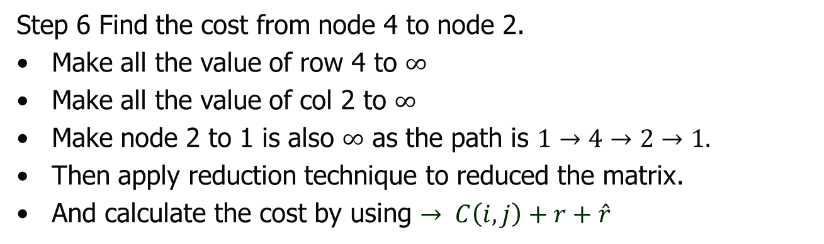


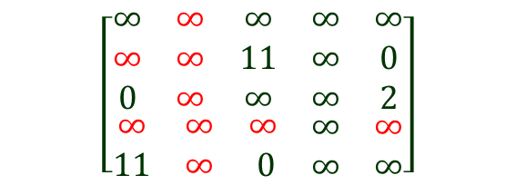
Travelling Salesman Problem
Example:
Step 6 Find the cost from node 4 to node 2.
Make all the value of row 4 to $∞$
Make all the value of col 2 to $∞$
Make node 2 to 1 is also $∞$ as the path is $1→4→2→1.$
Then apply reduction technique to reduced the matrix.
And calculate the cost by using $→ C\left(i,j\right)+r+\hat{r}$
$$\begin{matrix}\begin{matrix}1 & 2 & 3\end{matrix} & \begin{matrix} 4 & 5\end{matrix}\end{matrix}$$
$$\left[\begin{matrix}\begin{matrix}∞ & ∞ & ∞ \\ ∞ & ∞ & 11 \\ 0 & ∞ & ∞\end{matrix} & \begin{matrix}∞ & ∞ \\ ∞ & 0 \\ ∞ & 2\end{matrix} \\ \begin{matrix}∞ & ∞ & ∞ \\ 11 & ∞ & 0\end{matrix} & \begin{matrix}∞ & ∞ \\ ∞ & ∞\end{matrix}\end{matrix}\right]$$
$$\begin{matrix}\begin{matrix}1 \\ 2 \\ 3\end{matrix} \\ \begin{matrix}4 \\ 5\end{matrix}\end{matrix}$$

Slide 33
Travelling Salesman Problem
Example:
Step 6 Find the cost from node 4 to node 2.
Make all the value of row 4 to $∞$
Make all the value of col 2 to $∞$
Make node 2 to 1 is also $∞$ as the path is $1→4→2→1.$
Then apply reduction technique to reduced the matrix.
And calculate the cost by using $→ C\left(i,j\right)+r+\hat{r}$
$$\begin{matrix}\begin{matrix}1 & 2 & 3\end{matrix} & \begin{matrix} 4 & 5\end{matrix}\end{matrix}$$
$$\left[\begin{matrix}\begin{matrix}∞ & ∞ & ∞ \\ ∞ & ∞ & 11 \\ 0 & ∞ & ∞\end{matrix} & \begin{matrix}∞ & ∞ \\ ∞ & 0 \\ ∞ & 2\end{matrix} \\ \begin{matrix}∞ & ∞ & ∞ \\ 11 & ∞ & 0\end{matrix} & \begin{matrix}∞ & ∞ \\ ∞ & ∞\end{matrix}\end{matrix}\right]$$
Apply reduction technique and reduced the matrix
$$\begin{matrix}\begin{matrix}1 \\ 2 \\ 3\end{matrix} \\ \begin{matrix}4 \\ 5\end{matrix}\end{matrix}$$

Slide 34
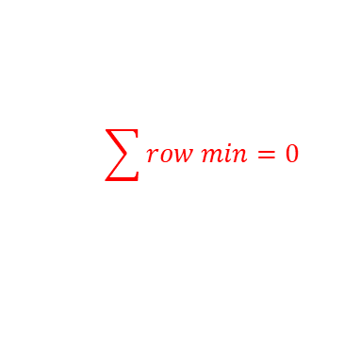

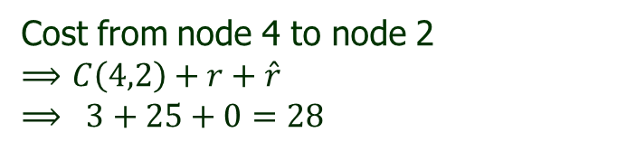


Travelling Salesman Problem
Example:
Step 6 Find the cost from node 4 to node 2.
Make all the value of row 4 to $∞$
Make all the value of col 2 to $∞$
Make node 2 to 1 is also $∞$ as the path is $1→4→2→1.$
Then apply reduction technique to reduced the matrix.
And calculate the cost by using $→ C\left(i,j\right)+r+\hat{r}$
$$\begin{matrix}\begin{matrix}1 & 2 & 3\end{matrix} & \begin{matrix} 4 & 5\end{matrix}\end{matrix}$$
$$\sum{row min}=0$$
$$\sum{row min}=0$$
$$\left[\begin{matrix}\begin{matrix}∞ & ∞ & ∞ \\ ∞ & ∞ & 11 \\ 0 & ∞ & ∞\end{matrix} & \begin{matrix}∞ & ∞ \\ ∞ & 0 \\ ∞ & 2\end{matrix} \\ \begin{matrix}∞ & ∞ & ∞ \\ 11 & ∞ & 0\end{matrix} & \begin{matrix}∞ & ∞ \\ ∞ & ∞\end{matrix}\end{matrix}\right]$$
$$\begin{matrix}\begin{matrix}1 \\ 2 \\ 3\end{matrix} \\ \begin{matrix}4 \\ 5\end{matrix}\end{matrix}$$
$$\begin{matrix}\begin{matrix}0 \\ 0 \\ 0\end{matrix} \\ \begin{matrix}0 \\ 0\end{matrix}\end{matrix}$$
Cost from node 4 to node 2
$⟹$ $C\left(4,2\right)+r+\hat{r}$
$$⟹ 3+25+0=28$$
$$\begin{matrix}\begin{matrix}0 & 0 & 0\end{matrix} & \begin{matrix} 0 & 0\end{matrix}\end{matrix}$$

Slide 35
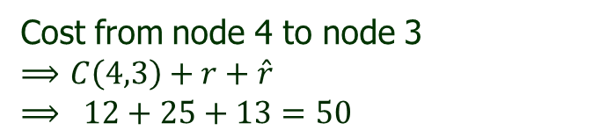
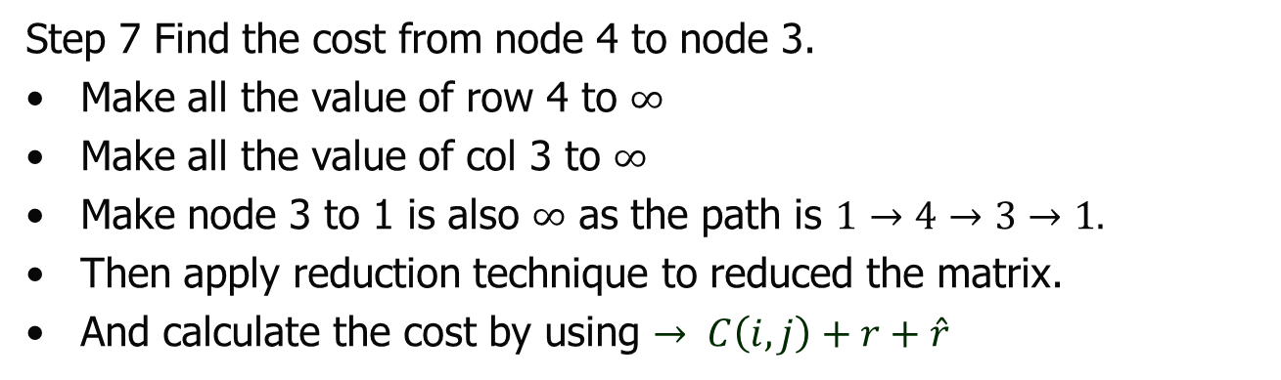





Travelling Salesman Problem
Example:
Step 7 Find the cost from node 4 to node 3.
Make all the value of row 4 to $∞$
Make all the value of col 3 to $∞$
Make node 3 to 1 is also $∞$ as the path is $1→4→3→1.$
Then apply reduction technique to reduced the matrix.
And calculate the cost by using $→ C\left(i,j\right)+r+\hat{r}$
$$\begin{matrix}\begin{matrix}1 & 2 & 3\end{matrix} & \begin{matrix} 4 & 5\end{matrix}\end{matrix}$$
$$\sum{row min}=2$$
$$\sum{row min}=3$$
$$\left[\begin{matrix}\begin{matrix}∞ & ∞ & ∞ \\ 12 & ∞ & ∞ \\ ∞ & 3 & ∞\end{matrix} & \begin{matrix}∞ & ∞ \\ ∞ & 0 \\ ∞ & 2\end{matrix} \\ \begin{matrix}∞ & ∞ & ∞ \\ 11 & 0 & ∞\end{matrix} & \begin{matrix}∞ & ∞ \\ ∞ & ∞\end{matrix}\end{matrix}\right]$$
$$\begin{matrix}\begin{matrix}1 \\ 2 \\ 3\end{matrix} \\ \begin{matrix}4 \\ 5\end{matrix}\end{matrix}$$
$$\begin{matrix}\begin{matrix}0 \\ 0 \\ 2\end{matrix} \\ \begin{matrix}0 \\ 0\end{matrix}\end{matrix}$$
Cost from node 4 to node 3
$⟹$ $C\left(4,3\right)+r+\hat{r}$
$$⟹ 12+25+13=50$$
$$\begin{matrix}\begin{matrix}11 & 0 & 0\end{matrix} & \begin{matrix} 0 & 0\end{matrix}\end{matrix}$$

Slide 36






Travelling Salesman Problem
Example:
Step 8 Find the cost from node 4 to node 5.
Make all the value of row 4 to $∞$
Make all the value of col 5 to $∞$
Make node 5 to 1 is also $∞$ as the path is $1→4→5→1.$
Then apply reduction technique to reduced the matrix.
And calculate the cost by using $→ C\left(i,j\right)+r+\hat{r}$
$$\begin{matrix}\begin{matrix}1 & 2 & 3\end{matrix} & \begin{matrix} 4 & 5\end{matrix}\end{matrix}$$
$$\sum{row min}=11$$
$$\sum{row min}=0$$
$$\left[\begin{matrix}\begin{matrix}∞ & ∞ & ∞ \\ 12 & ∞ & 11 \\ 0 & 3 & ∞\end{matrix} & \begin{matrix}∞ & ∞ \\ ∞ & ∞ \\ ∞ & ∞\end{matrix} \\ \begin{matrix}∞ & ∞ & ∞ \\ ∞ & 0 & 0\end{matrix} & \begin{matrix}∞ & ∞ \\ ∞ & ∞\end{matrix}\end{matrix}\right]$$
$$\begin{matrix}\begin{matrix}1 \\ 2 \\ 3\end{matrix} \\ \begin{matrix}4 \\ 5\end{matrix}\end{matrix}$$
$$\begin{matrix}\begin{matrix}0 \\ 11 \\ 0\end{matrix} \\ \begin{matrix}0 \\ 0\end{matrix}\end{matrix}$$
Cost from node 4 to node 3
$⟹$ $C\left(4,5\right)+r+\hat{r}$
$$⟹ 0+25+11=36$$
$$\begin{matrix}\begin{matrix}0 & 0 & 0\end{matrix} & \begin{matrix} 0 & 0\end{matrix}\end{matrix}$$

Slide 37
Travelling Salesman Problem
Example:
Hence the cost from
node 4 to node 2 =28
node 4 to node 3 =50
node 4 to node 5 =36
And the State space tree is grown as:
1
C1=25
2
C2=35
C3=53
C4=25
C5=31
3
4
5
2
3
5
C2=28
C3=50
C5=36

Slide 38



Travelling Salesman Problem
Example:
Hence the cost from
node 4 to node 2 =28 (Minimum)
node 4 to node 3 =50
node 4 to node 5 =36
And the State space tree is grown as:
1
C1=25
2
C2=35
C3=53
C4=25
C5=31
3
4
5
“Hence the reduced matrix obtained from node 4 to node 2 will be treated as reduced matrix for next level of the graph”
2
5
3
C2=28
C3=50
C5=36
$$\begin{matrix}\begin{matrix}1 & 2 & 3\end{matrix} & \begin{matrix} 4 & 5\end{matrix}\end{matrix}$$
$$\left[\begin{matrix}\begin{matrix}∞ & ∞ & ∞ \\ ∞ & ∞ & 11 \\ 0 & ∞ & ∞\end{matrix} & \begin{matrix}∞ & ∞ \\ ∞ & 0 \\ ∞ & 2\end{matrix} \\ \begin{matrix}∞ & ∞ & ∞ \\ 11 & ∞ & 0\end{matrix} & \begin{matrix}∞ & ∞ \\ ∞ & ∞\end{matrix}\end{matrix}\right]$$
Now further find who is the next vertex in next level?( i.e. node 3 or node 5)
Hint: Apply the same methodology
$$\begin{matrix}\begin{matrix}1 \\ 2 \\ 3\end{matrix} \\ \begin{matrix}4 \\ 5\end{matrix}\end{matrix}$$

Slide 39



Travelling Salesman Problem
Example:
C1=25
$$\begin{matrix}\begin{matrix}1 & 2 & 3\end{matrix} & \begin{matrix} 4 & 5\end{matrix}\end{matrix}$$
1
$$\left[\begin{matrix}\begin{matrix}∞ & ∞ & ∞ \\ ∞ & ∞ & 11 \\ 0 & ∞ & ∞\end{matrix} & \begin{matrix}∞ & ∞ \\ ∞ & 0 \\ ∞ & 2\end{matrix} \\ \begin{matrix}∞ & ∞ & ∞ \\ 11 & ∞ & 0\end{matrix} & \begin{matrix}∞ & ∞ \\ ∞ & ∞\end{matrix}\end{matrix}\right]$$
$$\begin{matrix}\begin{matrix}1 \\ 2 \\ 3\end{matrix} \\ \begin{matrix}4 \\ 5\end{matrix}\end{matrix}$$
2
C2=35
C3=53
C4=25
C5=31
3
4
5
2
3
5
C2=28
C3=50
C5=36
Now, we calculate the cost from node 2 to node 3, and node 2 to node 5.
And check, whether there is a minimum cost path from node 2 to node 3 or node 2 to node 5, is exists? And find which one is minimum and explore that node again. And show the procedure through state space tree.
Let us do it one by one……..

Slide 40


Travelling Salesman Problem
Example:
Step 9 Find the cost from node 2 to node 3.
Make all the value of row 2 to $∞$
Make all the value of col 3 to $∞$
Make node 3 to 1 is also $∞$ as the path is $1→4→2→3→1.$
Then apply reduction technique to reduced the matrix.
And calculate the cost by using $→ C\left(i,j\right)+r+\hat{r}$
$$\begin{matrix}\begin{matrix}1 & 2 & 3\end{matrix} & \begin{matrix} 4 & 5\end{matrix}\end{matrix}$$
$$\left[\begin{matrix}\begin{matrix}∞ & ∞ & ∞ \\ ∞ & ∞ & ∞ \\ ∞ & ∞ & ∞\end{matrix} & \begin{matrix}∞ & ∞ \\ ∞ & ∞ \\ ∞ & 2\end{matrix} \\ \begin{matrix}∞ & ∞ & ∞ \\ 11 & ∞ & ∞\end{matrix} & \begin{matrix}∞ & ∞ \\ ∞ & ∞\end{matrix}\end{matrix}\right]$$
$$\begin{matrix}\begin{matrix}1 \\ 2 \\ 3\end{matrix} \\ \begin{matrix}4 \\ 5\end{matrix}\end{matrix}$$

Slide 41







Travelling Salesman Problem
Example:
Step 9 Find the cost from node 2 to node 3.
Make all the value of row 2 to $∞$
Make all the value of col 3 to $∞$
Make node 3 to 1 is also $∞$ as the path is $1→4→2→3→1.$
Then apply reduction technique to reduced the matrix.
And calculate the cost by using $→ C\left(i,j\right)+r+\hat{r}$
$$\begin{matrix}\begin{matrix}1 & 2 & 3\end{matrix} & \begin{matrix} 4 & 5\end{matrix}\end{matrix}$$
$$\left[\begin{matrix}\begin{matrix}∞ & ∞ & ∞ \\ ∞ & ∞ & ∞ \\ ∞ & ∞ & ∞\end{matrix} & \begin{matrix}∞ & ∞ \\ ∞ & ∞ \\ ∞ & 2\end{matrix} \\ \begin{matrix}∞ & ∞ & ∞ \\ 11 & ∞ & ∞\end{matrix} & \begin{matrix}∞ & ∞ \\ ∞ & ∞\end{matrix}\end{matrix}\right]$$
$$\sum{row min}=13$$
$$\sum{row min}=13$$
$$\begin{matrix}\begin{matrix}1 \\ 2 \\ 3\end{matrix} \\ \begin{matrix}4 \\ 5\end{matrix}\end{matrix}$$
$$\begin{matrix}\begin{matrix}0 \\ 0 \\ 2\end{matrix} \\ \begin{matrix}0 \\ 11\end{matrix}\end{matrix}$$
Cost from node 4 to node 3
$⟹$ $C\left(2,3\right)+r+\hat{r}$
$$⟹ 11+28+26=65$$
$$\begin{matrix}\begin{matrix}11 & 0 & 0\end{matrix} & \begin{matrix} 0 & 2\end{matrix}\end{matrix}$$

Slide 42




Travelling Salesman Problem
Example:
Step 10 Find the cost from node 2 to node 5.
Make all the value of row 2 to $∞$
Make all the value of col 5 to $∞$
Make node 5 to 1 is also $∞$ as the path is $1→4→2→5→1.$
Then apply reduction technique to reduced the matrix.
And calculate the cost by using $→ C\left(i,j\right)+r+\hat{r}$
$$\begin{matrix}\begin{matrix}1 & 2 & 3\end{matrix} & \begin{matrix} 4 & 5\end{matrix}\end{matrix}$$
$$\left[\begin{matrix}\begin{matrix}∞ & ∞ & ∞ \\ ∞ & ∞ & ∞ \\ 0 & ∞ & ∞\end{matrix} & \begin{matrix}∞ & ∞ \\ ∞ & ∞ \\ ∞ & ∞\end{matrix} \\ \begin{matrix}∞ & ∞ & ∞ \\ ∞ & ∞ & 0\end{matrix} & \begin{matrix}∞ & ∞ \\ ∞ & ∞\end{matrix}\end{matrix}\right]$$
$$\sum{row min}=0$$
$$\sum{row min}=0$$
$$\begin{matrix}\begin{matrix}1 \\ 2 \\ 3\end{matrix} \\ \begin{matrix}4 \\ 5\end{matrix}\end{matrix}$$
$$\begin{matrix}\begin{matrix}0 \\ 0 \\ 0\end{matrix} \\ \begin{matrix}0 \\ 0\end{matrix}\end{matrix}$$
Cost from node 4 to node 3
$⟹$ $C\left(2,5\right)+r+\hat{r}$
$$⟹ 0+28+0=28$$
$$\begin{matrix}\begin{matrix}0 & 0 & 0\end{matrix} & \begin{matrix} 0 & 0\end{matrix}\end{matrix}$$

Slide 43
Travelling Salesman Problem
Example:
1
C1=25
Hence the cost from
node 2 to node 3 =65
node 2 to node 5 =28
And the State space tree is grown as:
2
C2=35
C3=53
C4=25
C5=31
3
4
5
C2=28
2
3
5
C3=50
C5=36
C3=65
3
5
C5=28

Slide 44

Travelling Salesman Problem
Example:
1
C1=25
Hence the cost from
node 2 to node 3 =65
node 2 to node 5 =28 (Minimum)
And the State space tree is grown as:
2
C2=35
C3=53
C4=25
C5=31
3
4
5
C2=28
2
3
5
“Hence the reduced matrix obtained from node 2 to node 5 will be treated as reduced matrix for next level of the graph”
C3=50
C5=36
C3=65
3
5
C5=28
$$\begin{matrix}\begin{matrix}1 & 2 & 3\end{matrix} & \begin{matrix} 4 & 5\end{matrix}\end{matrix}$$
$$\left[\begin{matrix}\begin{matrix}∞ & ∞ & ∞ \\ ∞ & ∞ & ∞ \\ 0 & ∞ & ∞\end{matrix} & \begin{matrix}∞ & ∞ \\ ∞ & ∞ \\ ∞ & ∞\end{matrix} \\ \begin{matrix}∞ & ∞ & ∞ \\ ∞ & ∞ & 0\end{matrix} & \begin{matrix}∞ & ∞ \\ ∞ & ∞\end{matrix}\end{matrix}\right]$$
Now further find who is the next vertex in next level?( i.e. node 3)
Hint: Apply the same methodology
$$\begin{matrix}\begin{matrix}1 \\ 2 \\ 3\end{matrix} \\ \begin{matrix}4 \\ 5\end{matrix}\end{matrix}$$

Slide 45




Travelling Salesman Problem
Example:
Step 11 Find the cost from node 5 to node 3.
Make all the value of row 5 to $∞$
Make all the value of col 3 to $∞$
Make node 3 to 1 is also $∞$ as the path is $1→4→2→5→3→1.$
Then apply reduction technique to reduced the matrix.
And calculate the cost by using $→ C\left(i,j\right)+r+\hat{r}$
$$\begin{matrix}\begin{matrix}1 & 2 & 3\end{matrix} & \begin{matrix} 4 & 5\end{matrix}\end{matrix}$$
$$\left[\begin{matrix}\begin{matrix}∞ & ∞ & ∞ \\ ∞ & ∞ & ∞ \\ ∞ & ∞ & ∞\end{matrix} & \begin{matrix}∞ & ∞ \\ ∞ & ∞ \\ ∞ & ∞\end{matrix} \\ \begin{matrix}∞ & ∞ & ∞ \\ ∞ & ∞ & ∞\end{matrix} & \begin{matrix}∞ & ∞ \\ ∞ & ∞\end{matrix}\end{matrix}\right]$$
$$\begin{matrix}\begin{matrix}1 \\ 2 \\ 3\end{matrix} \\ \begin{matrix}4 \\ 5\end{matrix}\end{matrix}$$

Slide 46


Travelling Salesman Problem
Example:
Step 11 Find the cost from node 5 to node 3.
Make all the value of row 5 to $∞$
Make all the value of col 3 to $∞$
Make node 3 to 1 is also $∞$ as the path is $1→4→2→5→3→1.$
Then apply reduction technique to reduced the matrix.
And calculate the cost by using $→ C\left(i,j\right)+r+\hat{r}$
$$\begin{matrix}\begin{matrix}1 & 2 & 3\end{matrix} & \begin{matrix} 4 & 5\end{matrix}\end{matrix}$$
$$\sum{row min}=0$$
$$\sum{row min}=0$$
$$\left[\begin{matrix}\begin{matrix}∞ & ∞ & ∞ \\ ∞ & ∞ & ∞ \\ ∞ & ∞ & ∞\end{matrix} & \begin{matrix}∞ & ∞ \\ ∞ & ∞ \\ ∞ & ∞\end{matrix} \\ \begin{matrix}∞ & ∞ & ∞ \\ ∞ & ∞ & ∞\end{matrix} & \begin{matrix}∞ & ∞ \\ ∞ & ∞\end{matrix}\end{matrix}\right]$$
$$\begin{matrix}\begin{matrix}1 \\ 2 \\ 3\end{matrix} \\ \begin{matrix}4 \\ 5\end{matrix}\end{matrix}$$
$$\begin{matrix}\begin{matrix}0 \\ 0 \\ 0\end{matrix} \\ \begin{matrix}0 \\ 0\end{matrix}\end{matrix}$$
Cost from node 4 to node 3
$⟹$ $C\left(5,3\right)+r+\hat{r}$
$$⟹ 0+28+0=28$$
$$\begin{matrix}\begin{matrix}0 & 0 & 0\end{matrix} & \begin{matrix} 0 & 0\end{matrix}\end{matrix}$$

Slide 47

Travelling Salesman Problem
Example:
1
C1=25
Hence the cost from
node 5 to node 3 =28
And the final State space tree is grown as:
Hence the final Path is :
$$1→4→2→5→3$$
(25) (25) (28) (28) (28)
2
C2=35
C3=53
C4=25
C5=31
3
4
5
C2=28
2
3
5
C3=50
C5=36
C3=65
3
5
C5=28
3
C3=28
$←Cost at each node$

Slide 48

Travelling Salesman Problem
Time Complexity:
As there are v(n-1)! Paths the complexity of TSP by using Branch and bound technique is $Ω(2^{n})$ and in worst case if the number of cities are ‘n’ then the complexity is $Ο\left(n^{n}\right)$
Suppose we have ‘n’ nodes (i.e. cities), then there is a need of generating all the permutation of (n-1) nodes. Hence the time complexity is $Ο\left(n−1\right)!$ . Which is equal to $Ο\left(2^{n−1}\right).$ So the final time complexity is $Ο(2^{n}.$ $n^{2})$

Slide 49

Thank U

